Slide 1

Colour blocks
Gloria Kwako
Onyx, club C

Slide 2
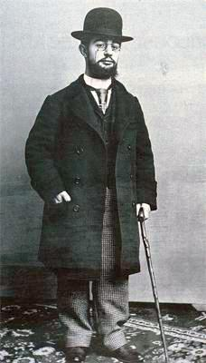

Slide 3




Slide 4
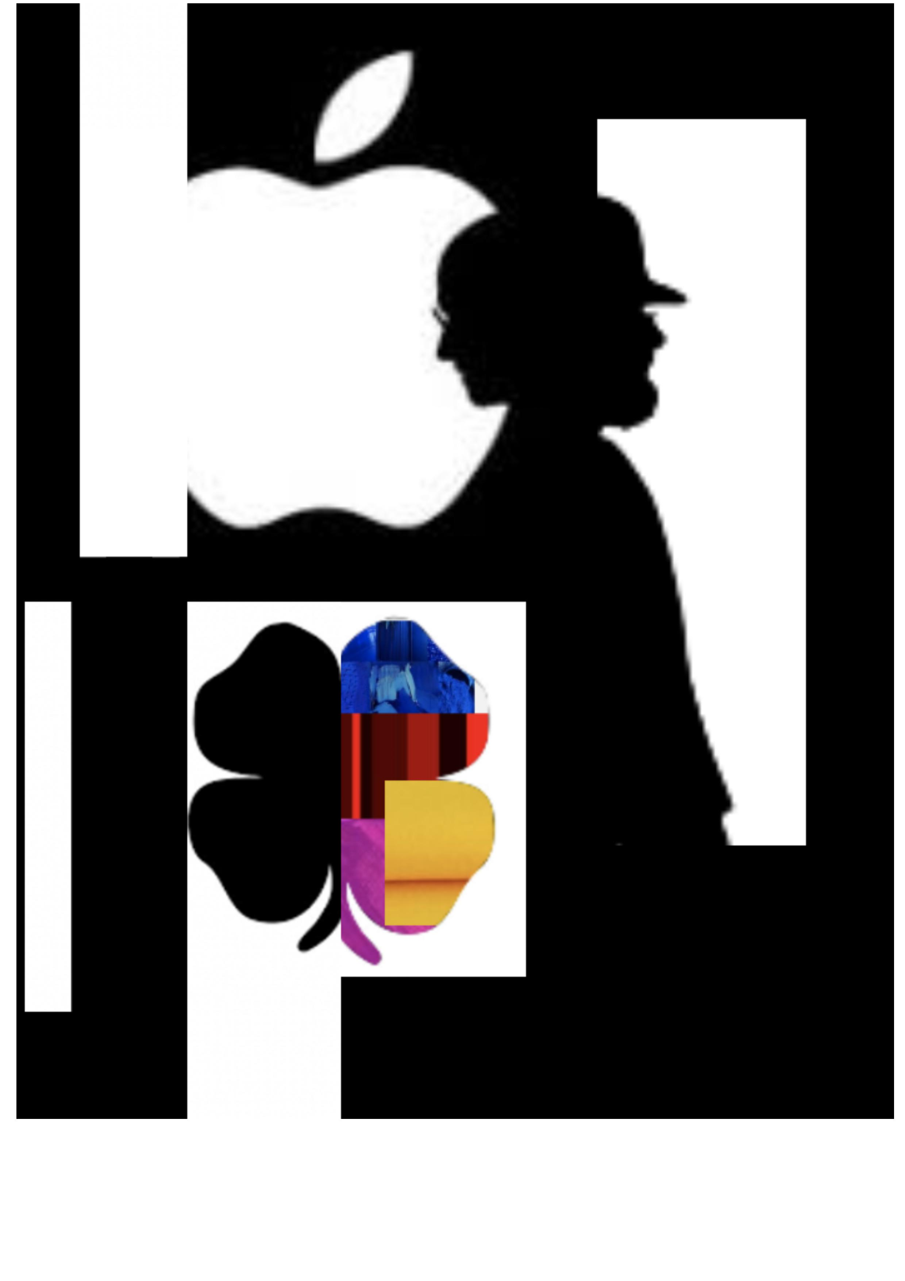

Slide 5
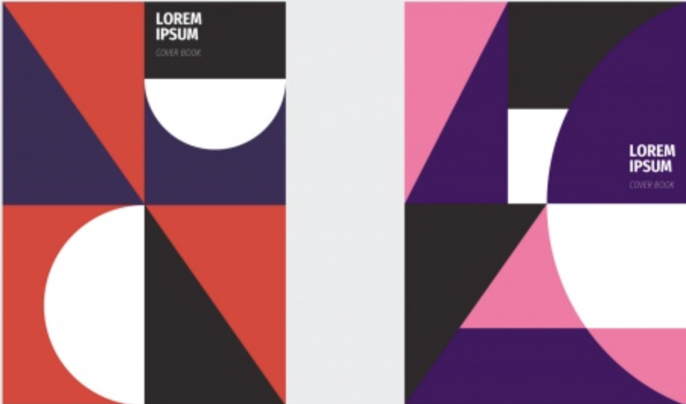


Slide 6



Slide 8
